Slide 1
Problem Statement
College campuses face significant challenges in managing vehicle movement and parking due to high traffic volumes and limited parking space availability.
Inefficient traffic flow and poorly managed parking lead to congestion, increased wait times, and frustration among students, staff, and visitors.
Traditional traffic management systems often rely on manual monitoring and static solutions, which are insufficient for dynamic and real-time traffic conditions.

Slide 2
Unique Idea Brief (Solution)
Harnessing the power of AI and edge computing to develop an integrated system for Automatic Number Plate Recognition (ANPR) and parking space detection.
Providing a real-time, scalable solution to enhance traffic flow, optimize parking space usage, and generate valuable insights for decision-making.
Improving immediate traffic conditions and contributing to long-term infrastructure planning and resource allocation on the campus.

Slide 3
Features Offered
Effective ANPR System: Accurate identification and tracking of vehicles in real-time.
Enhanced Parking Management: Optimization of parking lot utilization and reduction of congestion.
Edge AI Deployment: Real-time processing and low latency using TensorFlow Lite (TFLite).
Actionable Insights: Vehicle movement and parking patterns analysis for infrastructure planning and traffic management.

Slide 4
Process flow
Data Collection: Collecting images and videos from various parking lots and campus roads.
Data Preprocessing: Cleaning and annotating the dataset for training the models.
Model Training: Using TensorFlow Object Detection (TFOD) for ANPR and the SuperGradients library for parking space detection.
Model Optimization: Converting models to TensorFlow Lite (TFLite) for efficient edge deployment.
Edge Deployment: Deploying models on edge devices for real-time analysis.
Evaluation: Testing models for performance, accuracy, and reliability.

Slide 5
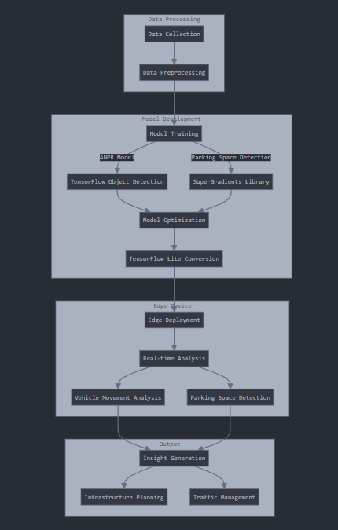
Architecture Diagram
Here is a visual representation of the architecture diagram for your presentation. This diagram outlines the process flow from data collection to evaluation:
Data Collection (Images/Videos)
Data Preprocessing (Cleaning/Annotation)
Model Training (TFOD, SuperGradients)
Model Optimization (TFLite)
Edge Deployment (Real-time Analysis)
Evaluation (Performance Testing)

Slide 6
Technologies used
TensorFlow Object Detection (TFOD): Used for training models for Automatic Number Plate Recognition (ANPR) and vehicle movement analysis.
SuperGradients: Utilized for training parking space detection models.
TensorFlow Lite (TFLite): Optimized models for edge deployment, ensuring real-time processing and low latency.
OpenCV: Employed for image processing and computer vision tasks.
EasyOCR: Implemented for Optical Character Recognition (OCR) to read text from vehicle plates.
Edge AI Devices: Deployed models on edge devices for real-time analysis and decision-making.
Python: Main programming language for developing and integrating various components of the project.
Jupyter Notebooks: Used for data analysis, experimentation, and model training.
Git: Version control system for tracking changes and collaborating with team members.

Slide 7
Team members and contribution:
Sayani Ghosh: Project Lead, Data Collection, Dataset Annotation, ANPR System Development, Edge Deployment
Arnab Dutta: Model Training, Parking Space Detection, Model Optimization, System Evaluation

Slide 8
Conclusion
The project effectively tackles vehicle movement and parking challenges on a college campus using AI and edge computing. By integrating TFOD, SuperGradients, TFLite, OpenCV, and EasyOCR, we developed a real-time ANPR and parking detection system that optimizes parking usage, reduces congestion, and provides valuable insights for traffic management. The edge deployment ensures efficient processing, making the system scalable and adaptable. Our AI-driven approach demonstrates significant improvements in operational efficiency and user experience, with future plans to enhance system capabilities and incorporate predictive analytics.

